Slide 1
MINI PROJECT
Presentation

Slide 2
Project Topic - Online Debate Room
Team Members
Josekutty Shoby ,Ben Paul Wilson ,Adarsh S Pallattu
Team Guide
Dr Jestin Joy

Slide 3
PROBLEM STATEMENT

Slide 4
PROPOSED SYSTEM

Slide 5
FEATURES OF PROPOSED SYSTEM

Slide 6
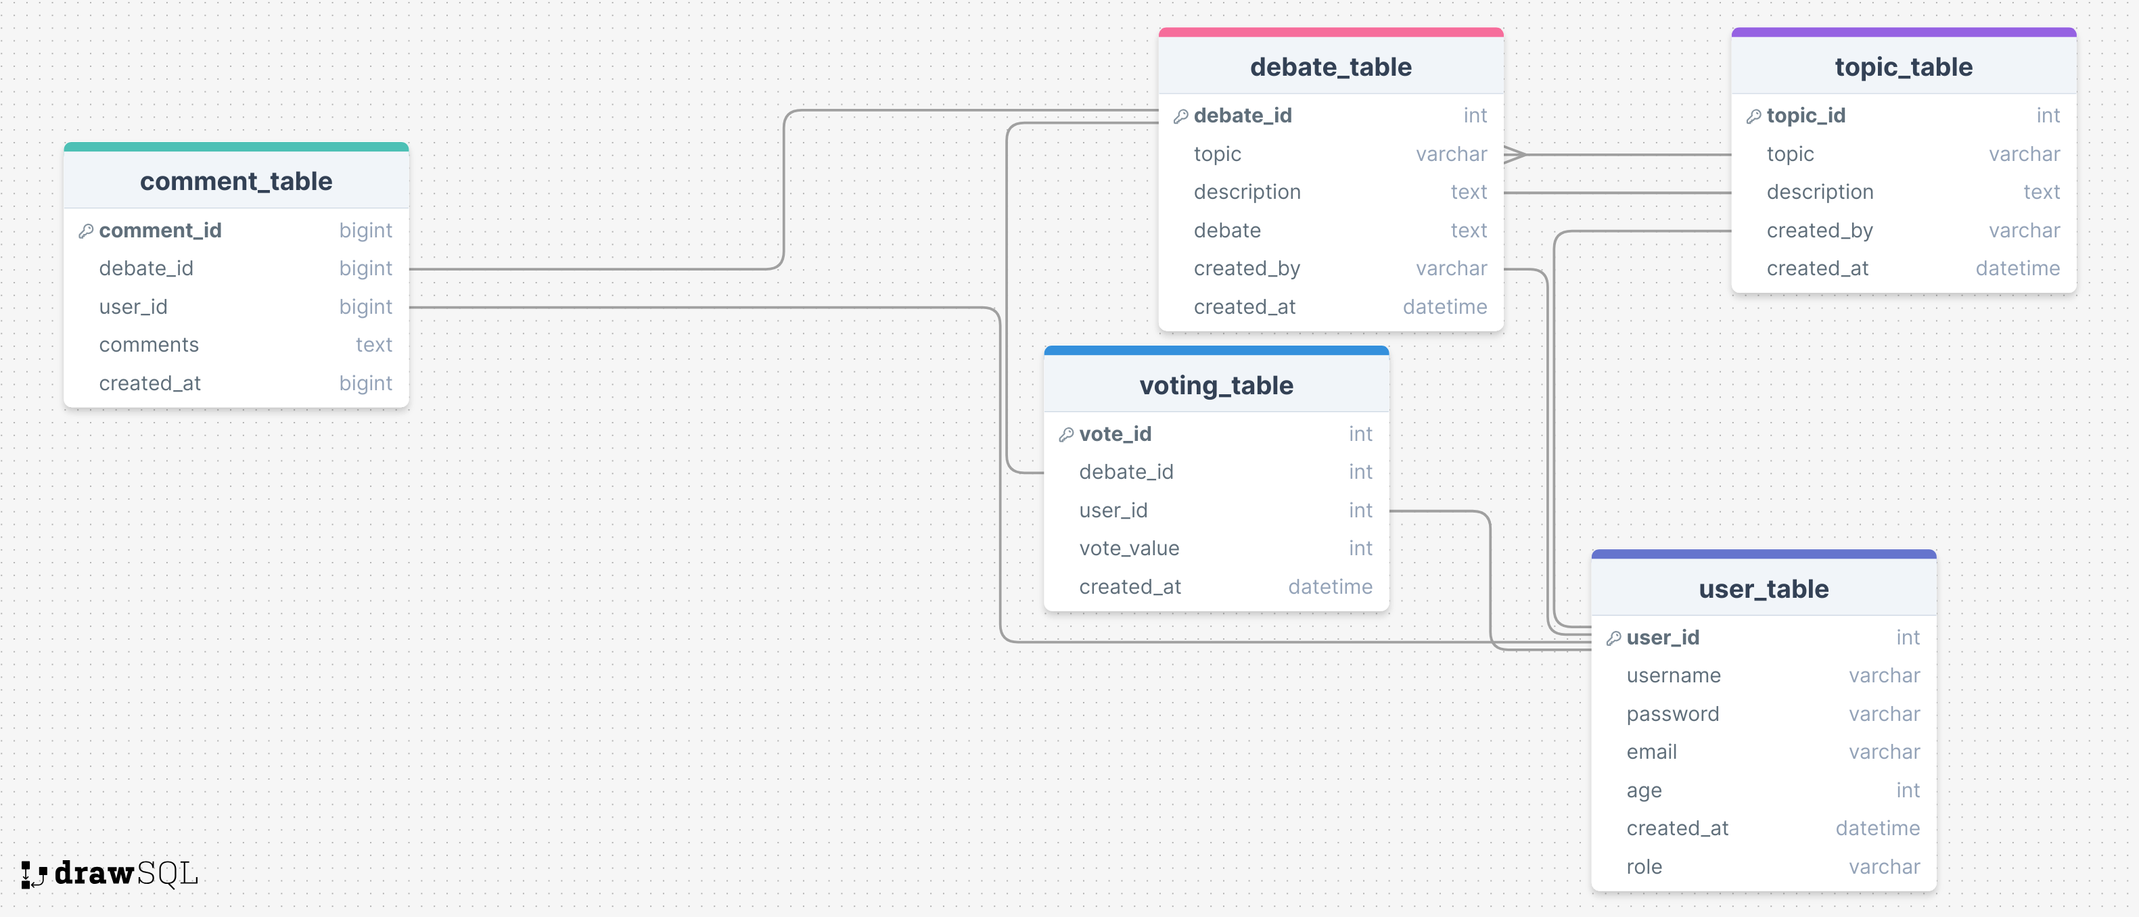
DATABASE SCHEMA

Slide 7
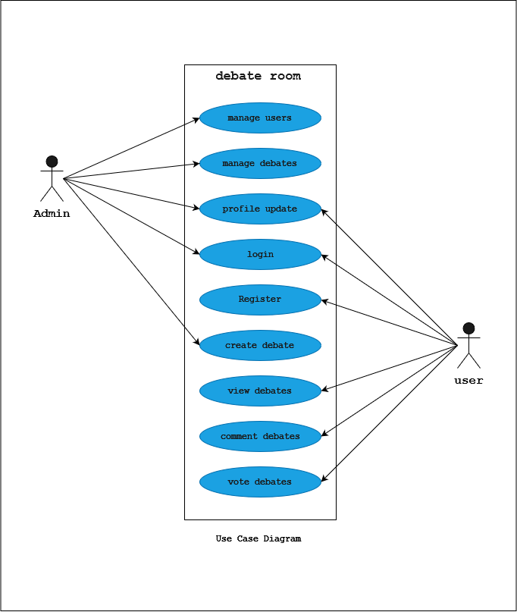
USECASE DIAGRAM

Slide 8
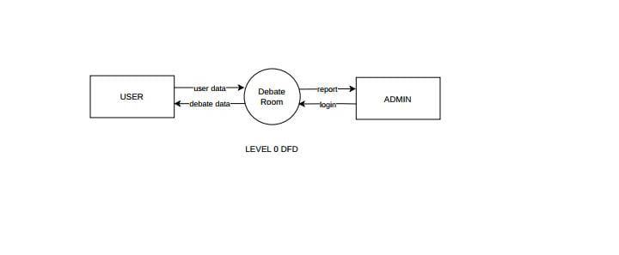
DFD

Slide 9
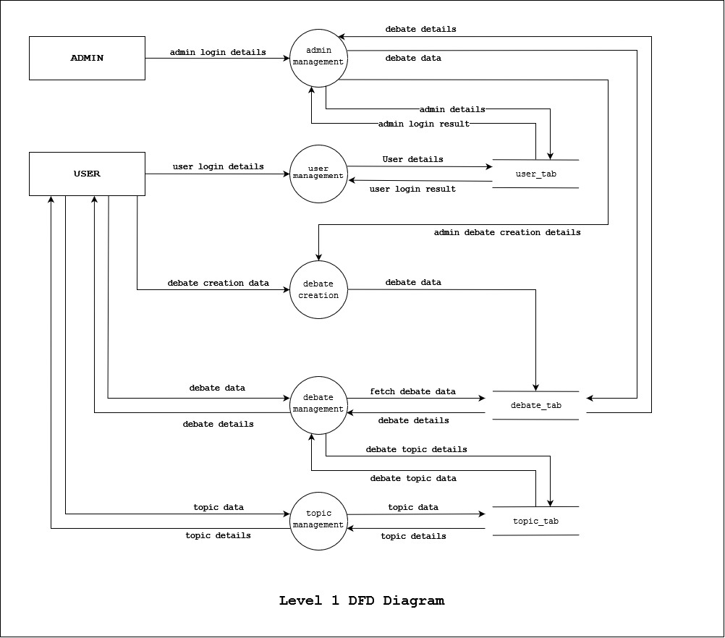

Slide 10
IMPLEMENTATIONS
Font Ent
HTML
CSS
JavaScript
Back Ent
sql
php

